Slide 1
Snake AI
Zhiyuan Liang & Yining Wang & Kaiyuan Xu& Weijia Lin

Slide 2
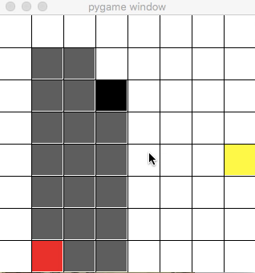
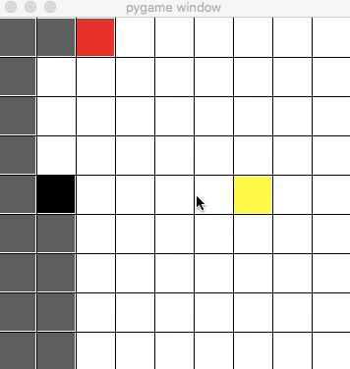
About Snake Game
State
Position of food & Positions of all parts of snake’s body
A strategy following fixed pattern
Even side length
Odd side length

Slide 3
Search

Slide 4
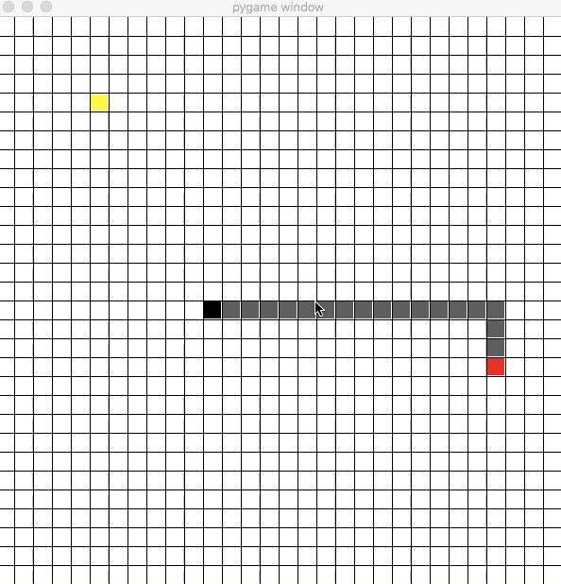
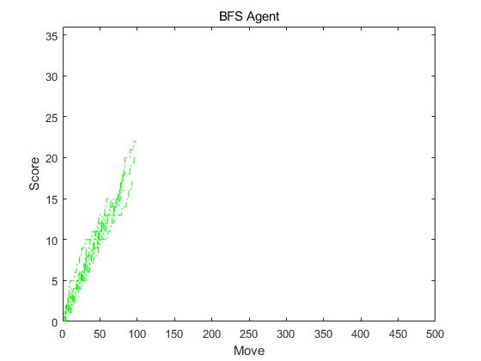
Search Algorithm
BFS
Greedy
Greedy

Slide 5
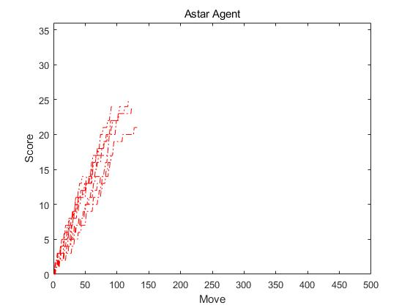
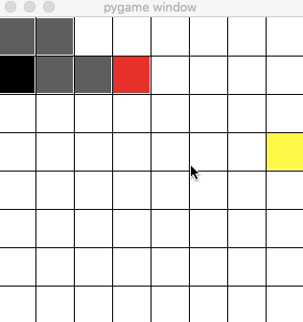
Search Algorithm
Astar
Heuristics: Manhattan Distance between snake head and food
6x6 Map

Slide 6
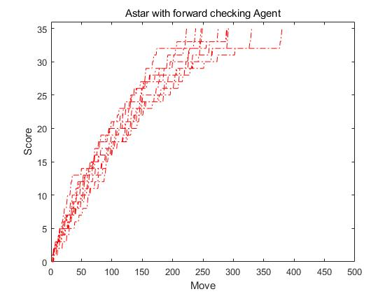
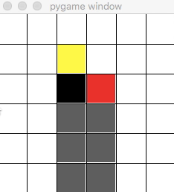
Search Algorithm
Astar with Forward Checking
The forward checking is n-step, it will do a n-step BFS to check whether all successores in n-step are possible dead ends. Here we consider the situation that the snake can not
move following its tail as the dead end.
A* with 2-stepForward Checking
on 6x6 Map
A* on 6x6 Map
A* with 2-stepForward Checking
on 6x6 Map

Slide 7
Search Algorithm
All search algorithms which order by path cost or backward cost are too resource consuming. Greedy orders by goal proximity or forward cost, therefore it is not very resource consuming.
If the forward checking step number is big enough, search algorithm can ensure snake to eat all food and fill the whole screen.

Slide 8
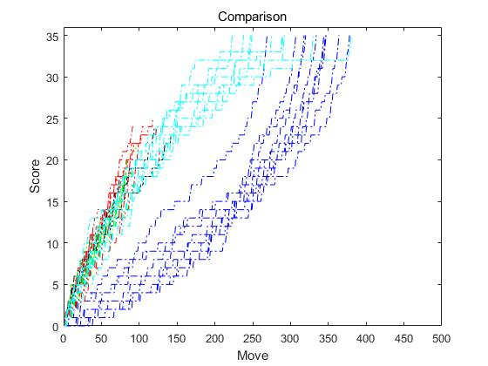
6x6 Map

Slide 9
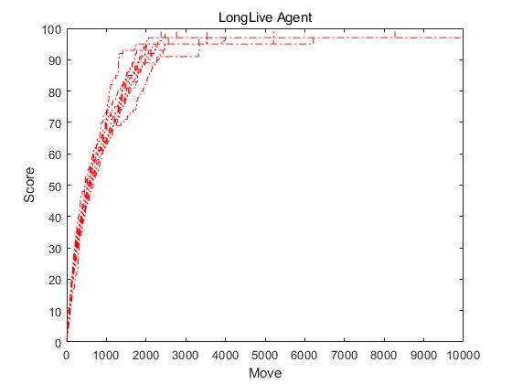
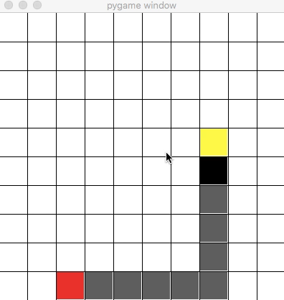
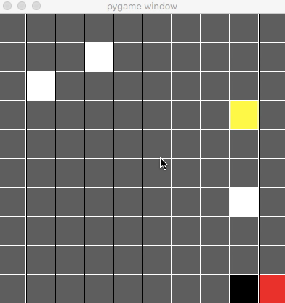
Search Algorithm
A modified search algorithm
This strategy is to add a very conservative forward checking to greedy.
This strategy can ensure that the snake will never die, but it may never fill the whole map.
When there is no obvious path to the food or if it follows the found path, it seems like to get it into danger. In both cases, the snake will take the most conservative action i.e. following its tail.

Slide 10
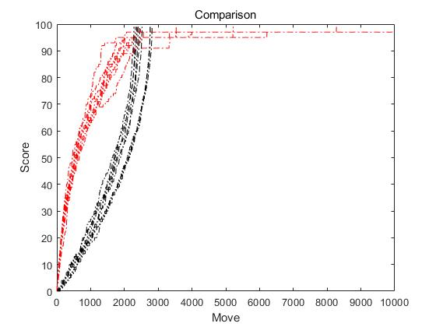
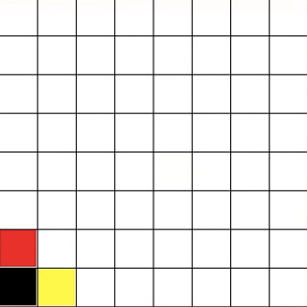
Performance on 10x10 Map

Slide 11
Reinforcement Learning

Slide 12
Reinforcement Learning
The main problem is that the state space of snake game is too large.
Solution: Feature-Based Representation
Features:
Obstacle left ∈ {0， 1}
Obstacle right ∈ {0， 1}
Obstacle up ∈ {0， 1}
Obstacle down∈ {0， 1}
Direction of food to head ∈ {(dirx, diry) | dirx = 0, 1 diry = 0, 1}
The state size is compressed to 2^4*8 = 128

Slide 13
RL
First Try
Directly trained on a 20x20 map
Greedy-Epsilon (decreasing Epsilon)
Episodes = 500
Learning rate = 0.9
Discounting = 0.8
Rewards:
eatFoodReward = 500
deathReward = -500
getCloserReward = 100
GetFurtherReward = -50
Train effect is bad.

Slide 14
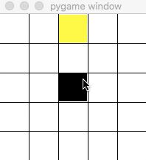
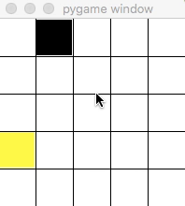
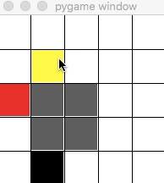
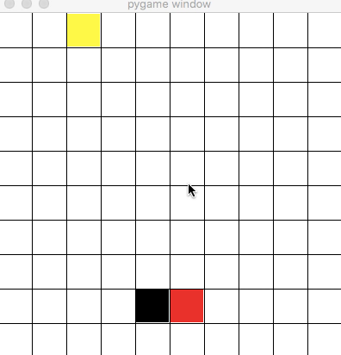
RL
New Train Process
Directly trained on a 5x5 map
Greedy-Epsilon (decreasing Epsilon)
Episodes = 200
Learning rate = 0.9
Discounting = 0.8
Rewards:
eatFoodReward = 100
deathReward = -500
getCloserReward = 0
GetFurtherReward = 0
The snake learnt how to survive.

Slide 15
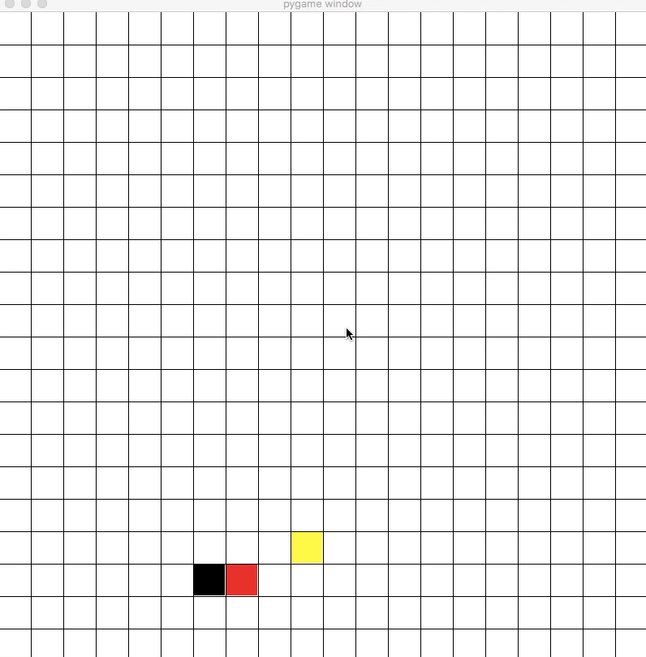
RL
Continued Train Process
Directly trained on a 20x20 map
Episodes = 50
Learning rate = 0.5
Discounting = 0.9
Rewards:
eatFoodReward = 500
deathReward = -500
getCloserReward = 100
GetFurtherReward = -50

Slide 16
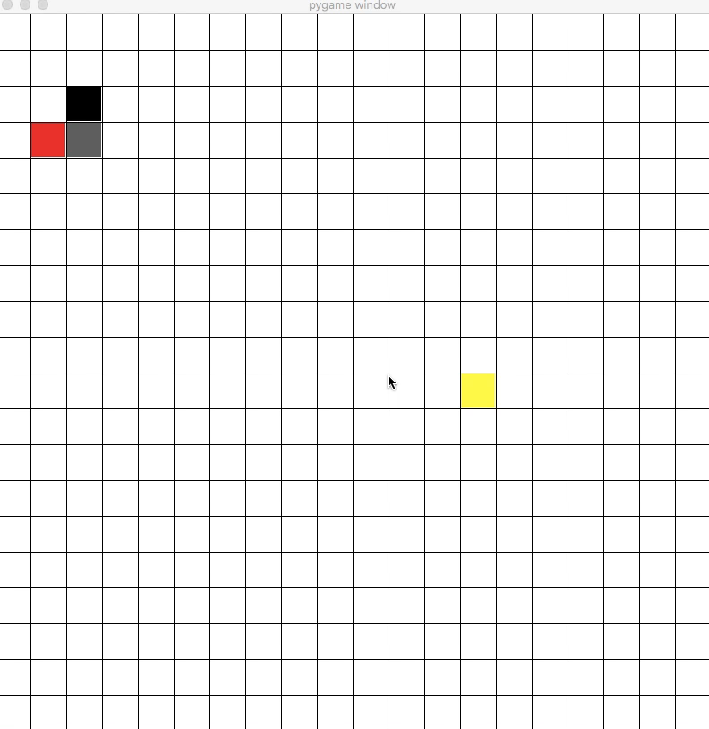
RL
Continued Train Process
Directly trained on a 20x20 map
Greedy-Epsilon (Epsilon is reset)
Episodes = 100
Learning rate = 0.5
Discounting = 0.9
Rewards:
eatFoodReward = 500
deathReward = -500
getCloserReward = 100
GetFurtherReward = -50

Slide 17
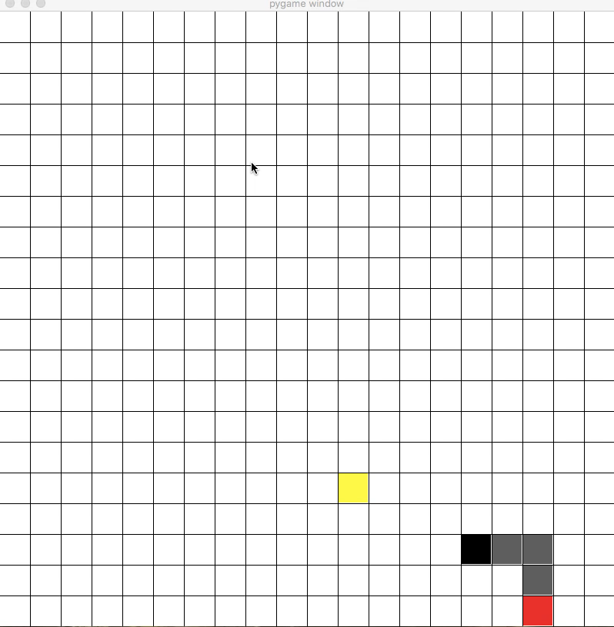
RL
Continued Train Process
Directly trained on a 20x20 map
Episodes = 50
Learning rate = 0.5
Discounting = 0.9
Rewards:
eatFoodReward = 500
deathReward = -500
getCloserReward = 100
GetFurtherReward = -50
Train effect is good.

Slide 18
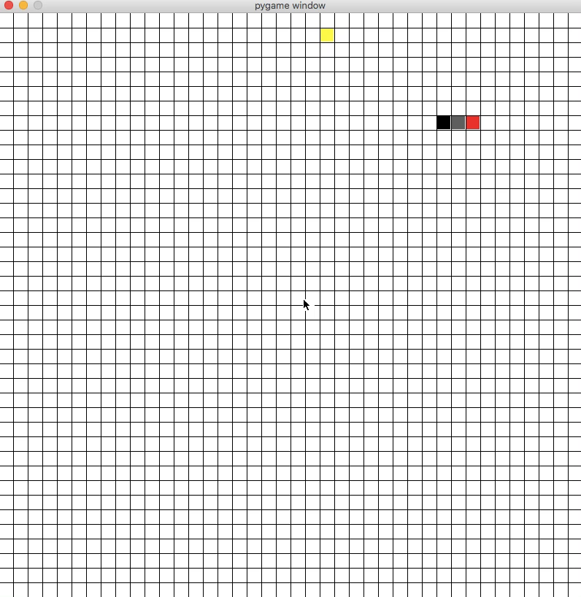

Slide 19
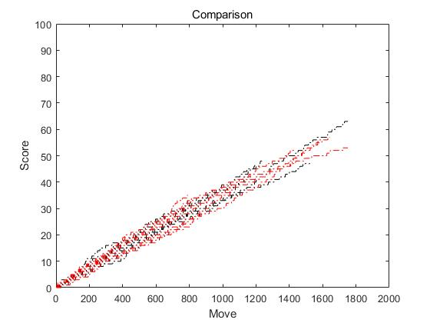

Slide 20
Reinforcement Learning
Maybe we can use RL to improve the LongLive agent mentioned before. We can use RL to let program to learn when to follow tail and when to eat food.
DQN is much more suitable for Snake AI because it can handle huge state size and predict unexploited state.

Slide 21
Thank You

